Slide 1

Application of Occlusion Culling in graphics Rendering
Tianshi Xie
Computer Science Dept.
Troy University

Slide 2
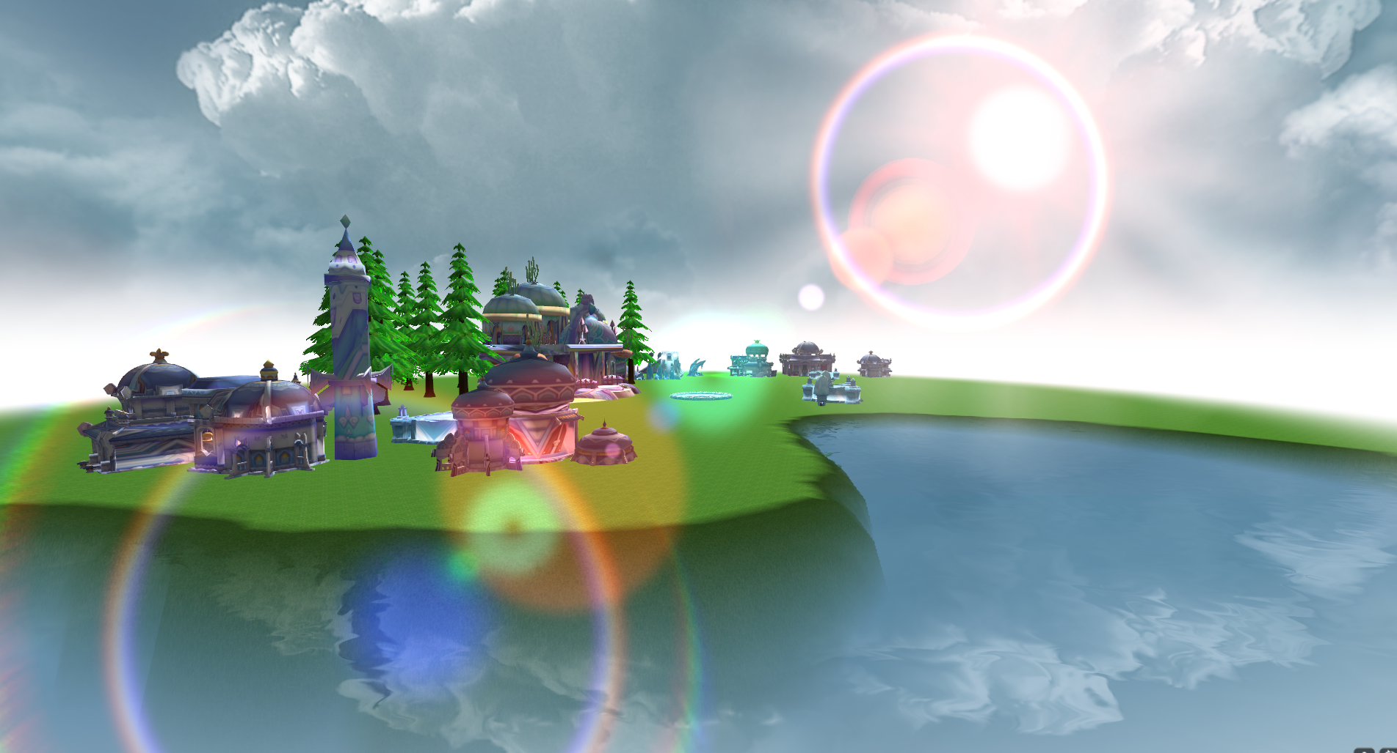
Abstract

Slide 3
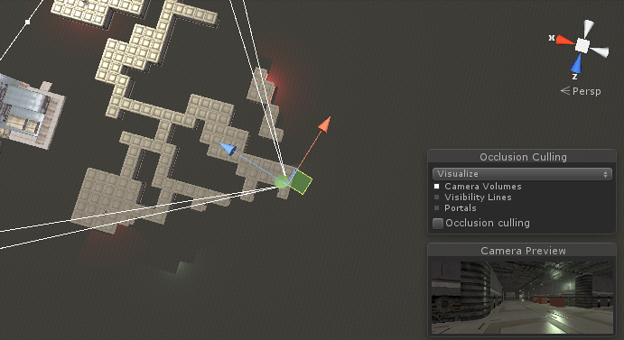
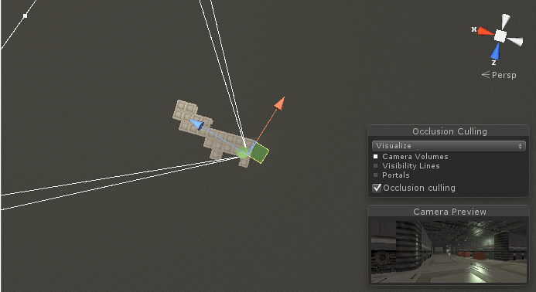
Introduction
Frustum culling[1]
Occlusion culling[2]

Slide 4
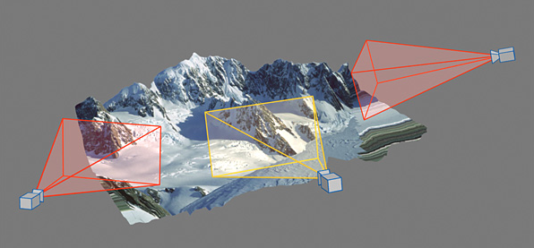
Introduction
Draw Call[3]
Rendering Performance[4]
The process of occlusion query

Slide 5
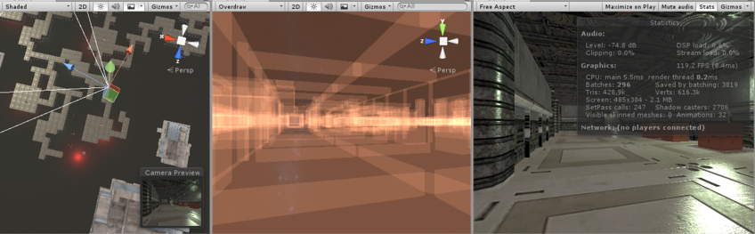
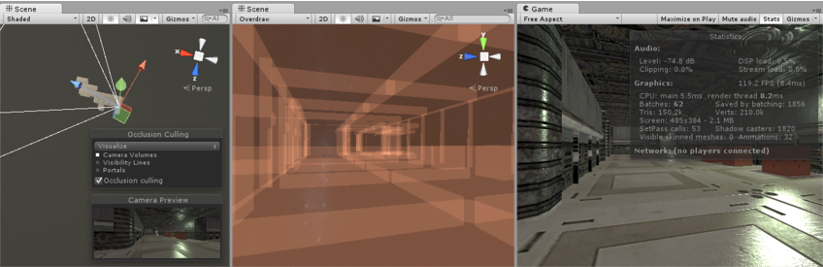
Introduction

Slide 6
How does the Occlusion query work
Query
Disable depth buffer
Depth Testing[5]
Drawing
Enable depth buffer
The Number of Visible Pixels
Screen

Slide 7
How does the Occlusion query work
synchronized
CPU
command
GPU
glDrawArrays[6]
Application
Rendering Process[7]

Slide 8
How does the Occlusion query work
Draw …
continues
Draw Font
Draw GUI
Draw house
CPU
command
GPU
Application
Rendering Process

Slide 9
How does the Occlusion query work
parallel
CMD1
CMD2
CMD3
.
.
.
CMDN
CPU
command
GPU
without any delay
Application
Rendering Process

Slide 10
How does the Occlusion query work
parallel
CPU
command
GPU
Information
Application
Rendering Process
A little bit of problem : query something on GPU

Slide 11
How does the Occlusion query work
Check
(OpenGL[8] function)
Result

Slide 12
How does the Occlusion query work
Step 1
Query
Step 2
While(…)
Result
Process of carrying out the query

Slide 13
How does the Occlusion query work
parallel
Idle
Idle
CPU
command
GPU
Next Frame
Application
Rendering Process
Problem : Idle
Solution : Next Frame

Slide 14
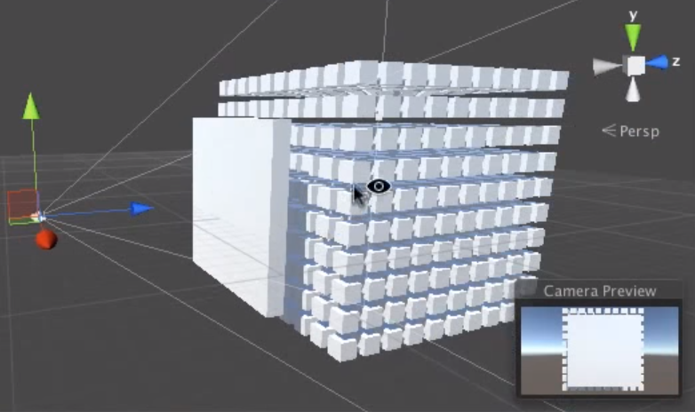
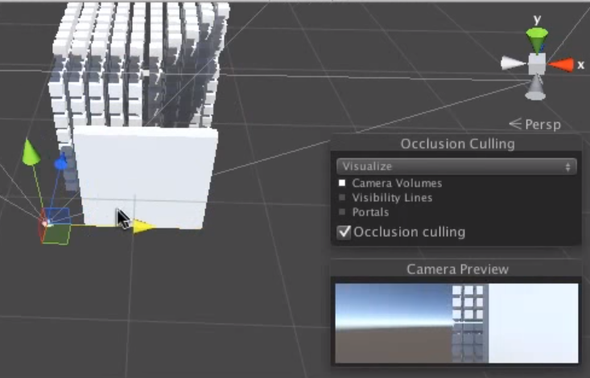
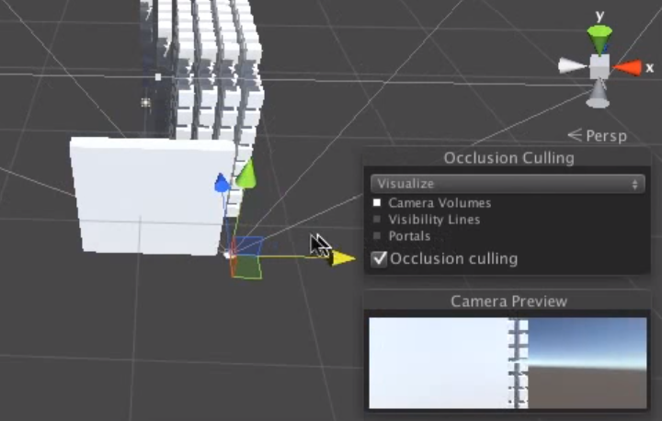
How does the Occlusion query work
Unity[9]
Without Occlusion query
Enable Occlusion query

Slide 15
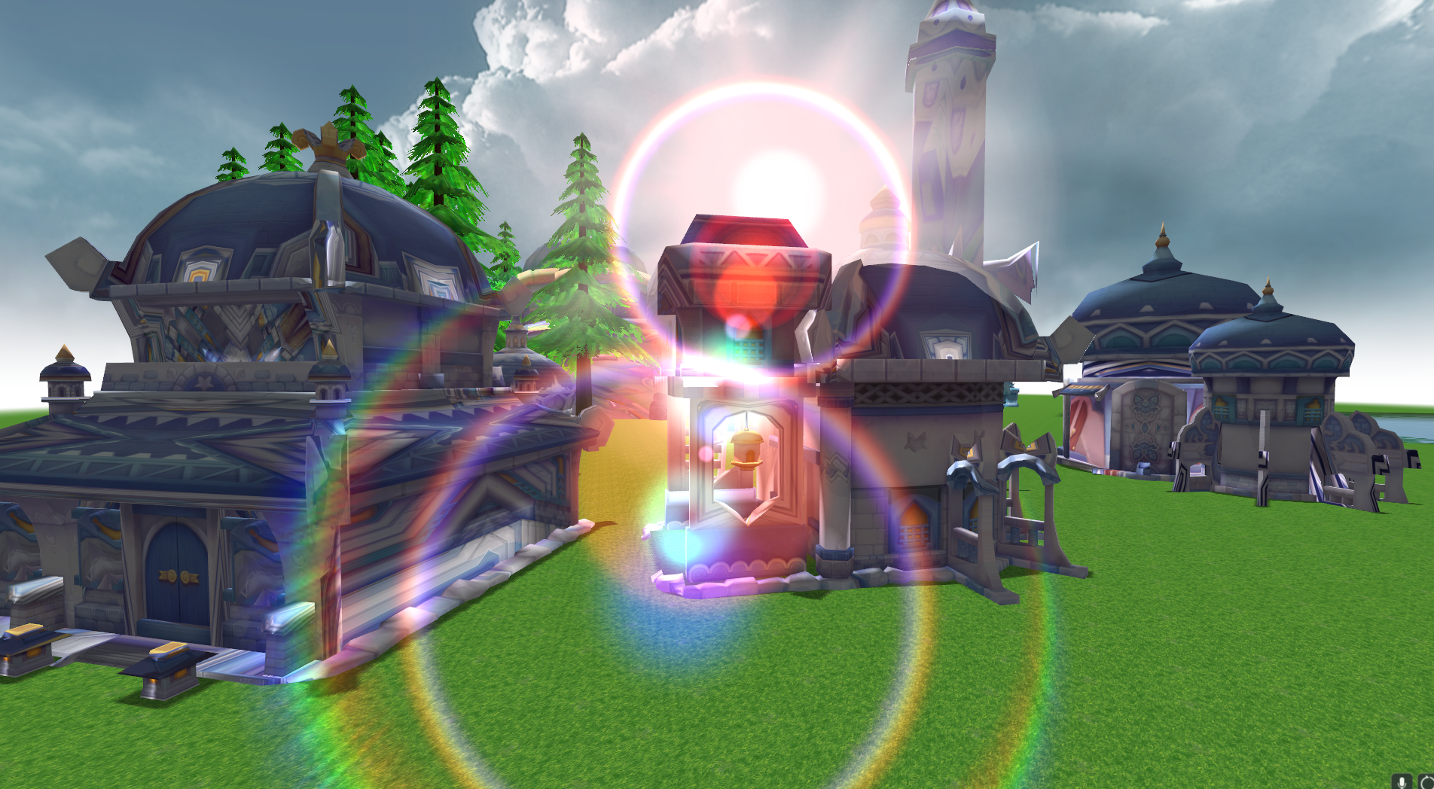
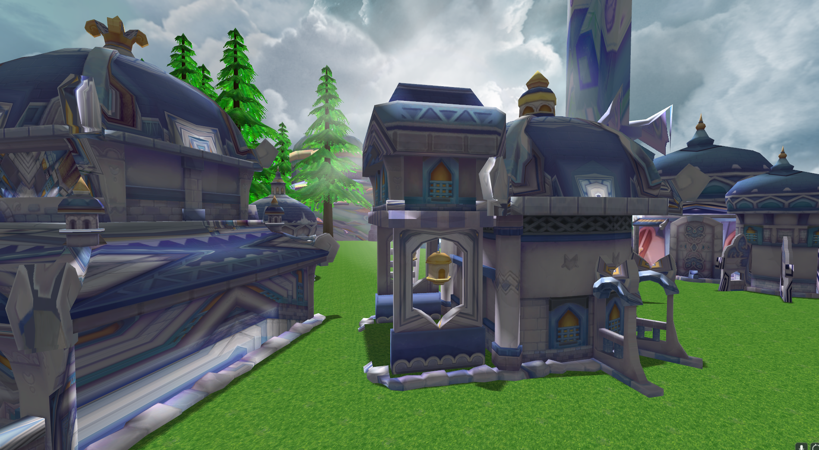
Demo

Slide 16
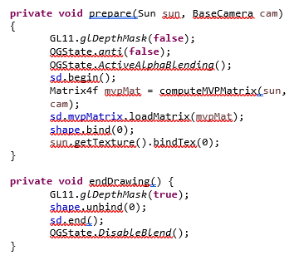
Code

Slide 17
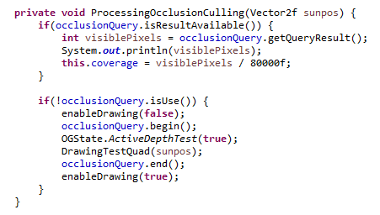
Code

Slide 18

Result
Number of visible pixels
80000
42316
0
1
0.52
0
Large Number (2) amount of the quad (3) Passing the depth test

Slide 19
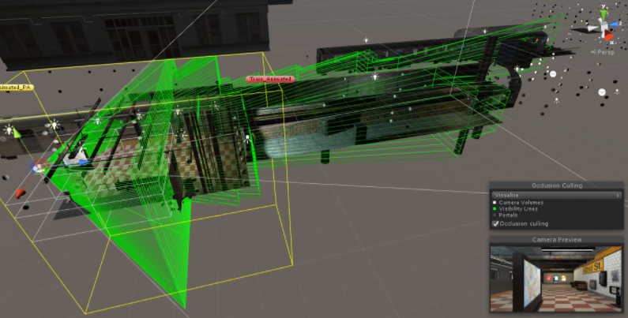
Future work - DirectX[10]

Slide 20
Conclusions
Occlusion Culling
Theory
Lens Flare
DirectX Platform

Slide 21
References
[1] Fast-extraction-viewing-frustum-planes-from-world-view-projection-matrix
[2] Occlusion Culling with Statistically Optimized Occlusion Queries
[3] High-performance, Low-Overhead Rendering with OpenGL - Nvidia
[4] Homomorphic Factorization of BRDFs for High-Performance Rendering
[5] Depth In-depth - Semantic Scholar
[6] What Every CUDA Programmer Should Know About OpenGL - Nvidia
[7] Rendering
[8] An Interactive Introduction to OpenGL Programming
[9] New Unity products
[10] Learn Network Inspire

